Slide 1

Can you imagine
As a Child, Your Imagination Made Books Come Alive
Could You Imagine Learning Like This As an Adult?
Image Adapted From: https://www.deviantart.com/orit770/art/Books-Coming-Alive-849545001

Slide 2
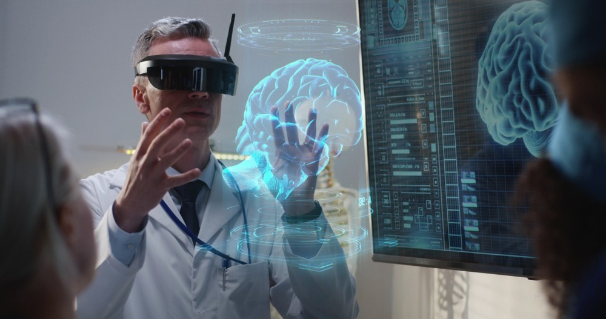
Virtual Reality (VR) Technology Can Be Used To Create Living Textbooks & More Memorable Experiences
Project Vison & Overall Value
Image Adapted From: https://www.linkedin.com/pulse/how-vr-aids-psychological-treatment-naveen-joshi

Slide 3
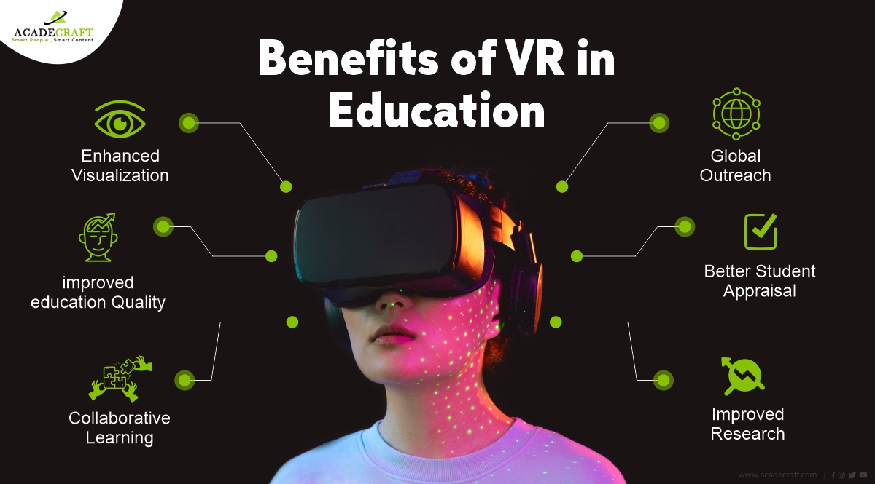
Adapted From: https://www.acadecraft.com/blog/top-benefits-of-using-virtual-reality-solutions/

Slide 4
Advantages of VR Educational Training Over a Traditional Textbook
The Problem You’re Solving
Cheaper
Offers more applied learning to develop procedural skills
Offers similar conceptual learning
Accelerates the learning process in a shorter time-period
Taught in shorter bursts of modules, increasing time to use procedural skills
Follows the “see one, do one, teach one” approach to learning
Learn by making errors with no harm, decreased costs, and increased proficiency

Slide 5

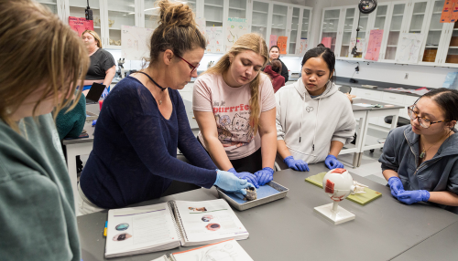
Students in Amphitheatre's and Large Labs
Have Reduced Learning of These Procedural Skills
The Stakeholders

Slide 6
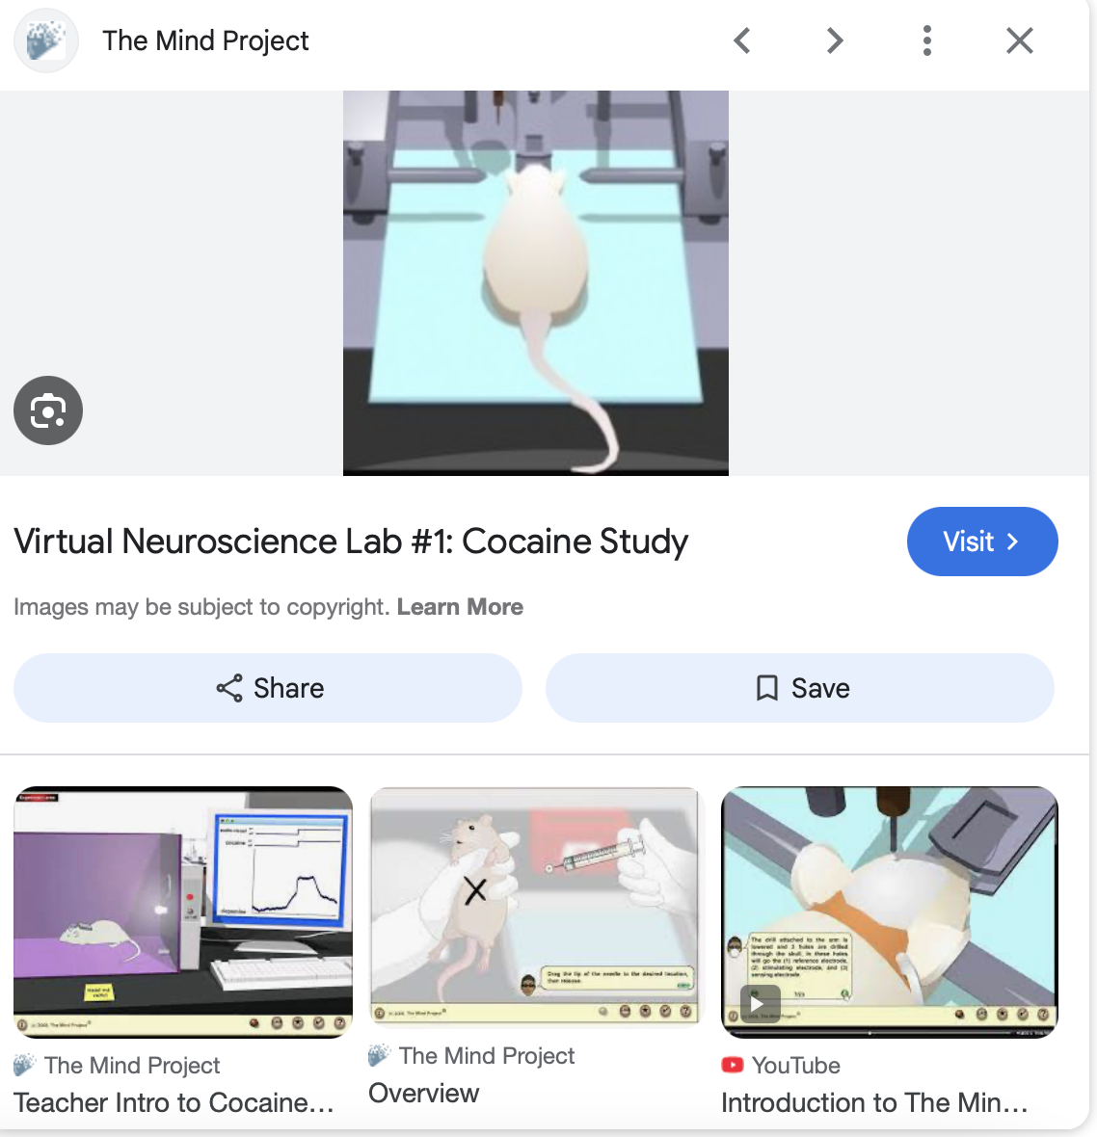
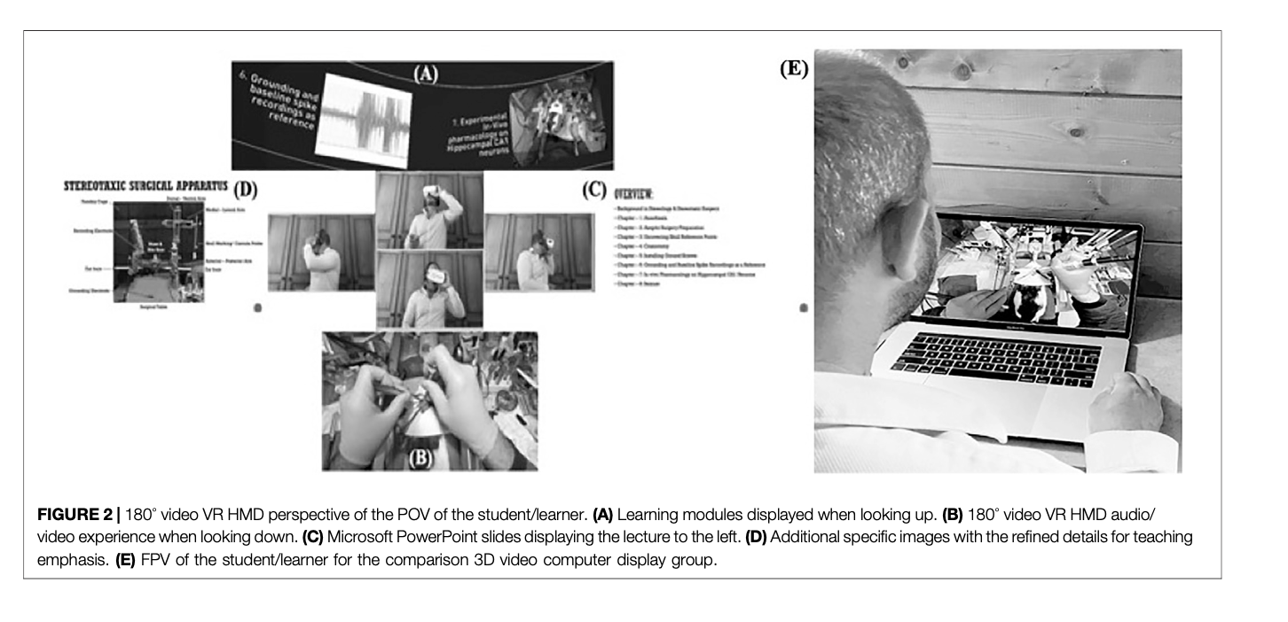
VR Learning Environments Are Effective In Bringing The Experience Up Close To All?
The Solution
FP-POV-VR Is Ideal
Good Conceptual Learning
Strong Procedural Learning
Computer Displayed-FP-POV-VR Is Ideal
Strong Conceptual Learning
Good Procedural Learning
Avatar Gaming Is Not Ideal
Fair Conceptual Learning
Weak Procedural Learning
Adapted From HHMI: Mind Project
Neuwirth & Ros (2021). https://doi.org/10.3389/frvir.2021.706653

Slide 7
First-Person Point-of-View (FP-POV) VR
Neuwirth & Ros (2021). https://doi.org/10.3389/frvir.2021.706653

Slide 8
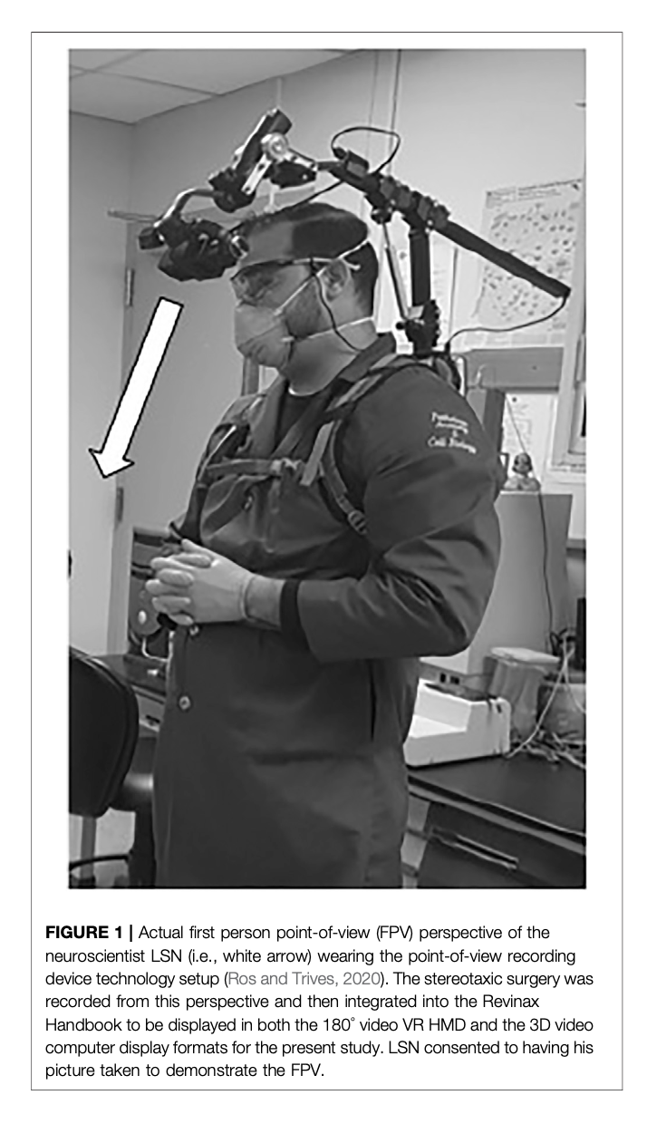

First-Person Point-of-View (FP-POV) VR
Exploits The Mirror Neuron System
Learn by watching others
Understand empathy
Learn by seeing then doing
Accelerated learning
No experience required
Closes learning gaps
Memorable content
Faster skills development
Evolutionarily Conserved
Fast-adaptive learning system
Adapted From: https://www.psychologytoday.com/us/blog/vitality/201407/the-neuroscience-vitality-tip-2-mirror-neurons
Neuwirth & Ros (2021). https://doi.org/10.3389/frvir.2021.706653

Slide 9


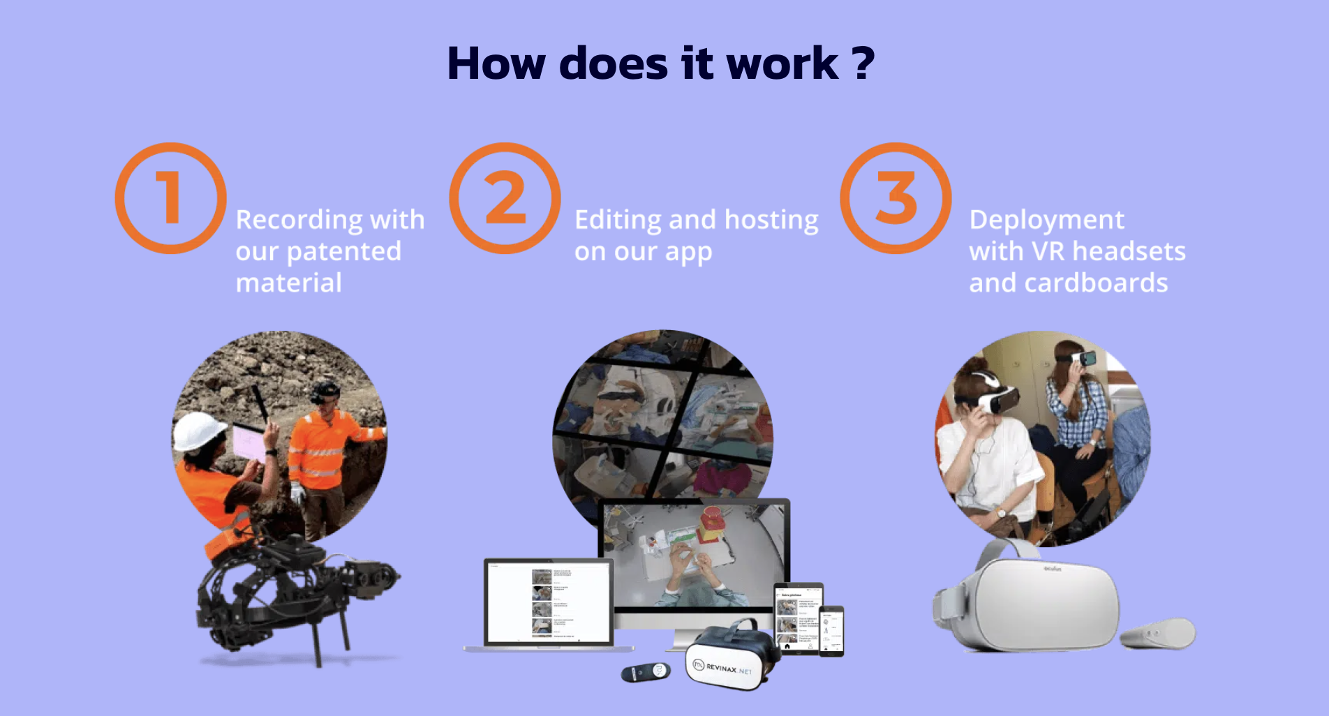
Partners For Developing The Product
Environmental Analysis

Slide 10
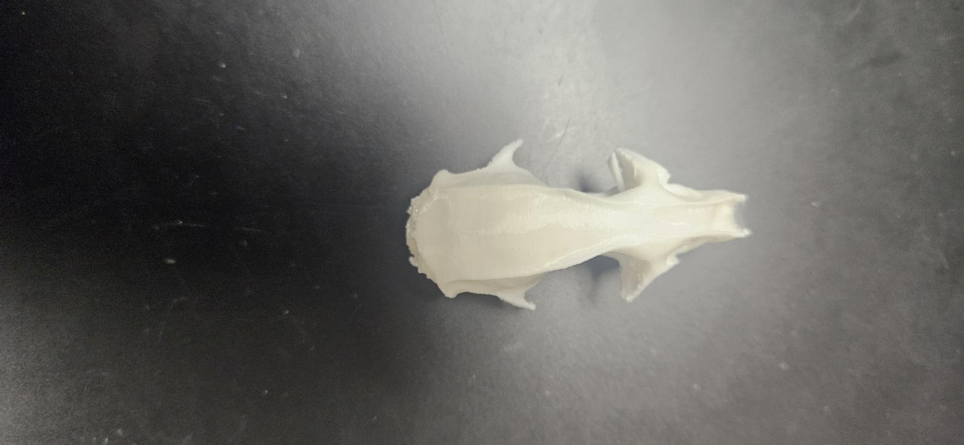
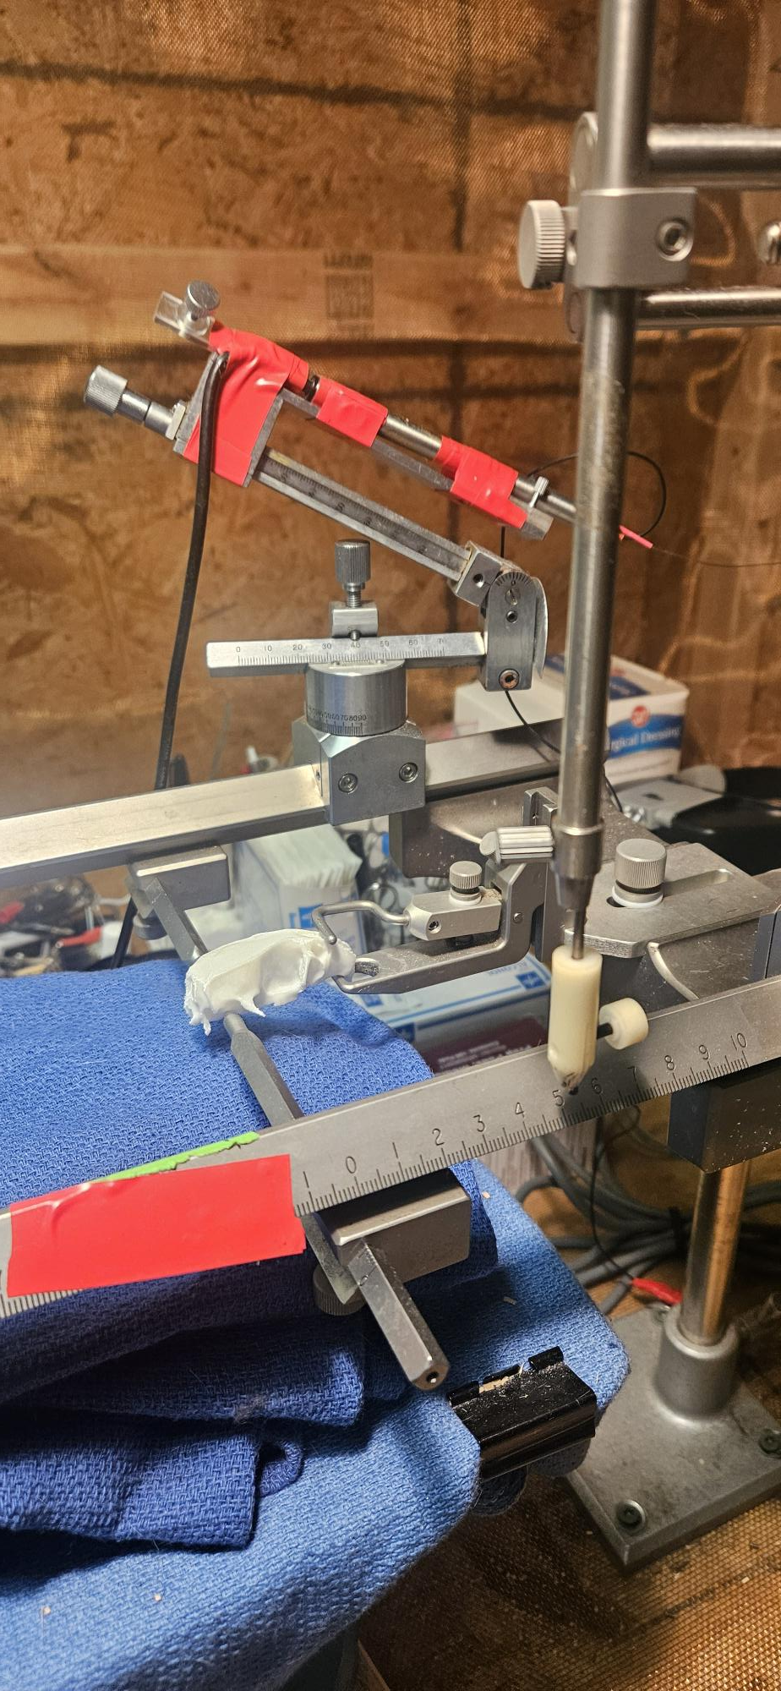
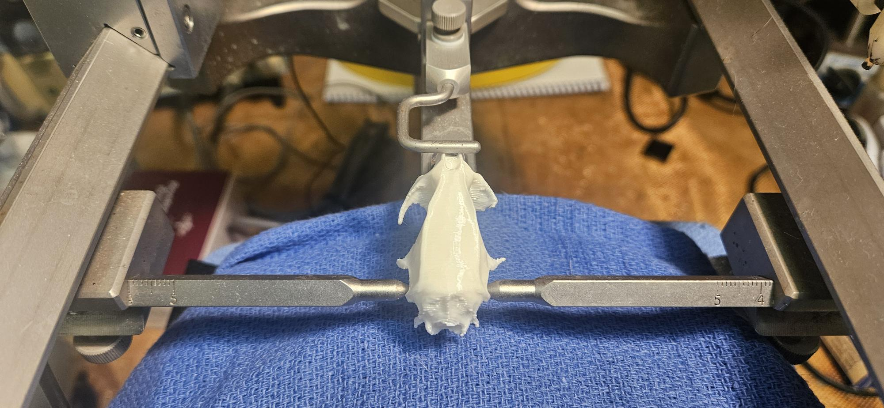
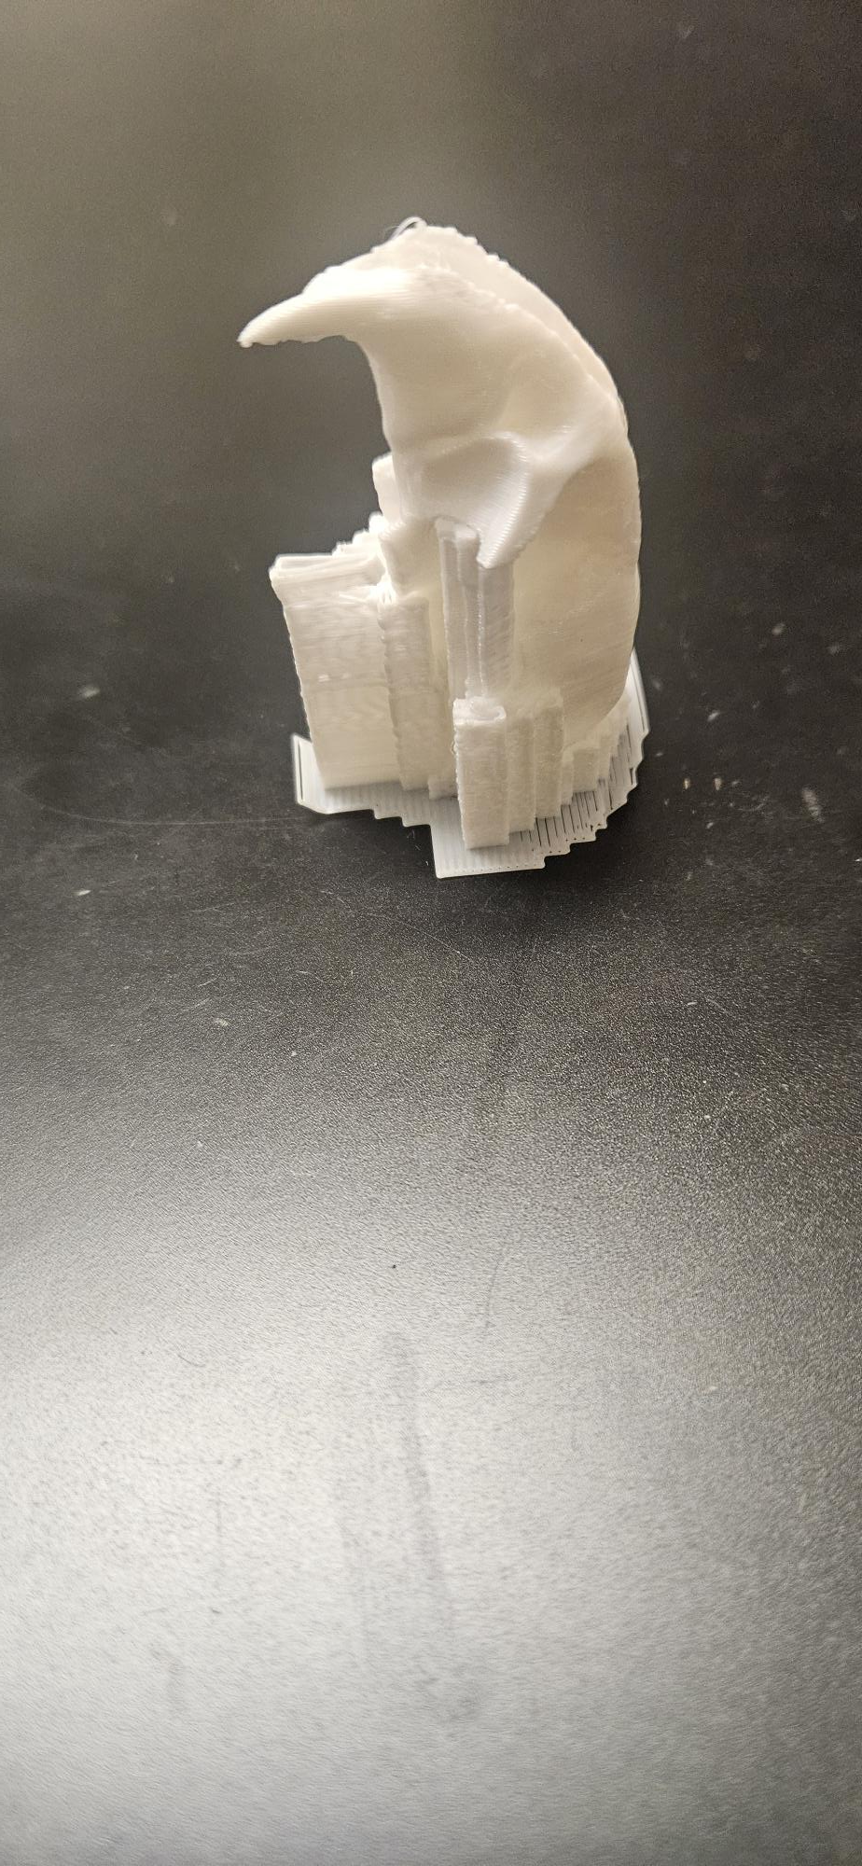
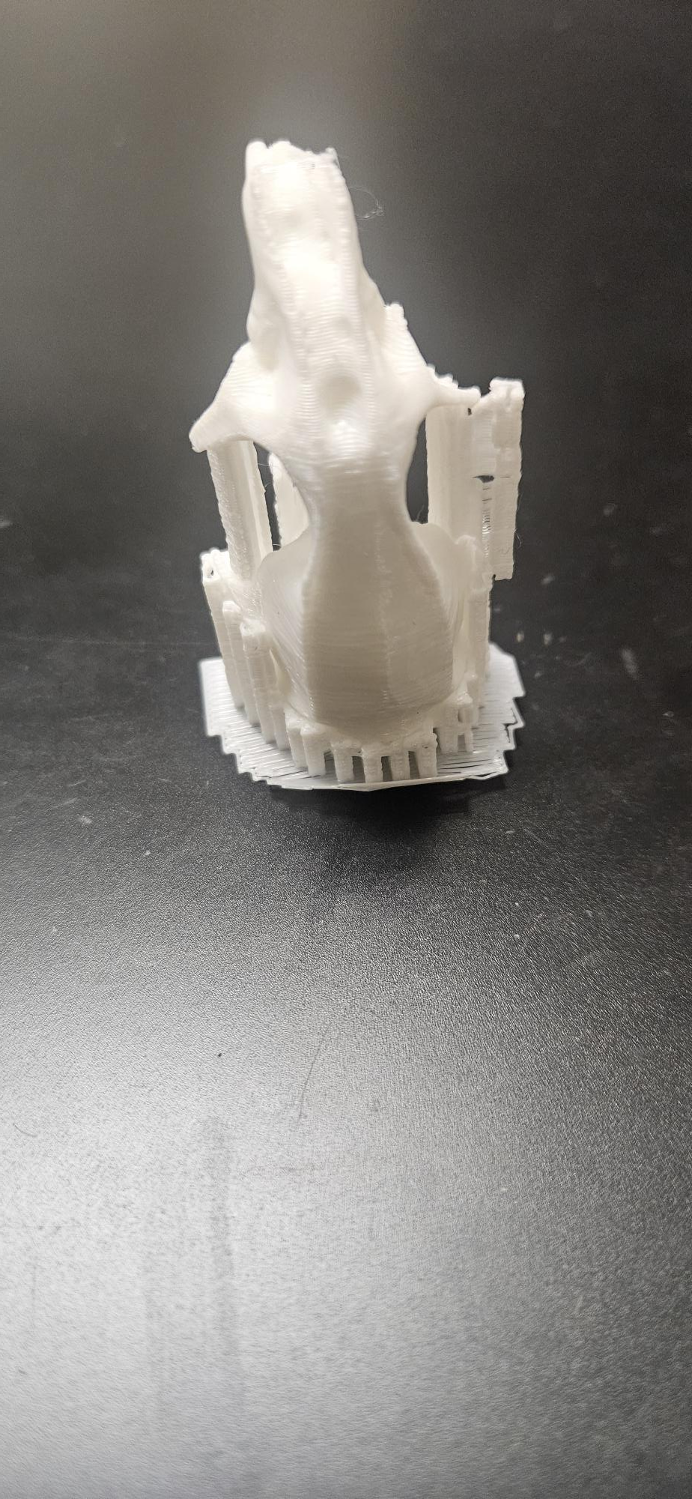
Students Can Then Translate The VR Training
Learning By Making Errors
Without Consequences
Basic Road Map & Milestones

Slide 11
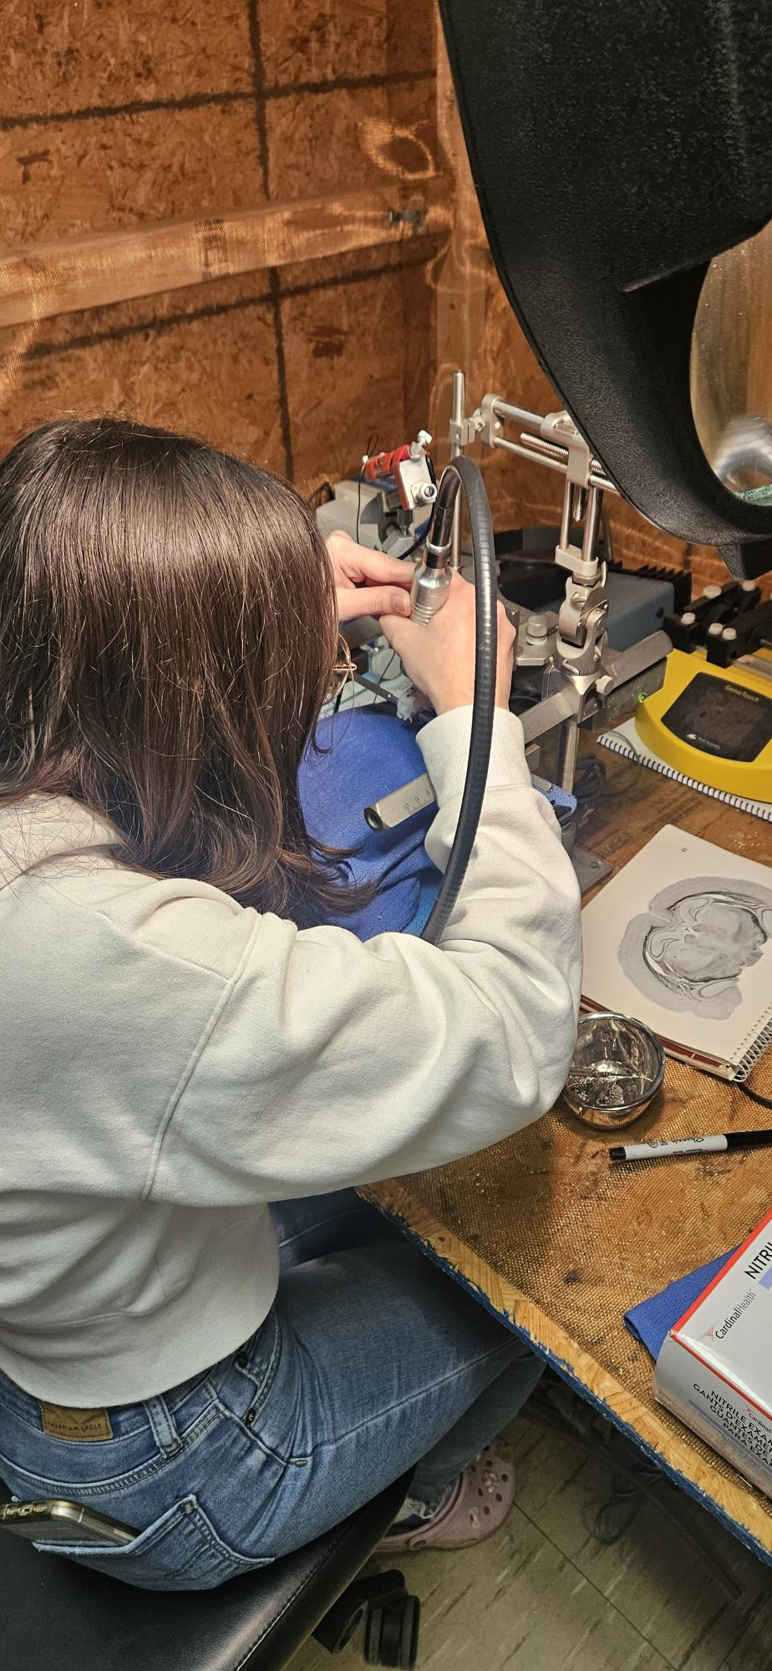
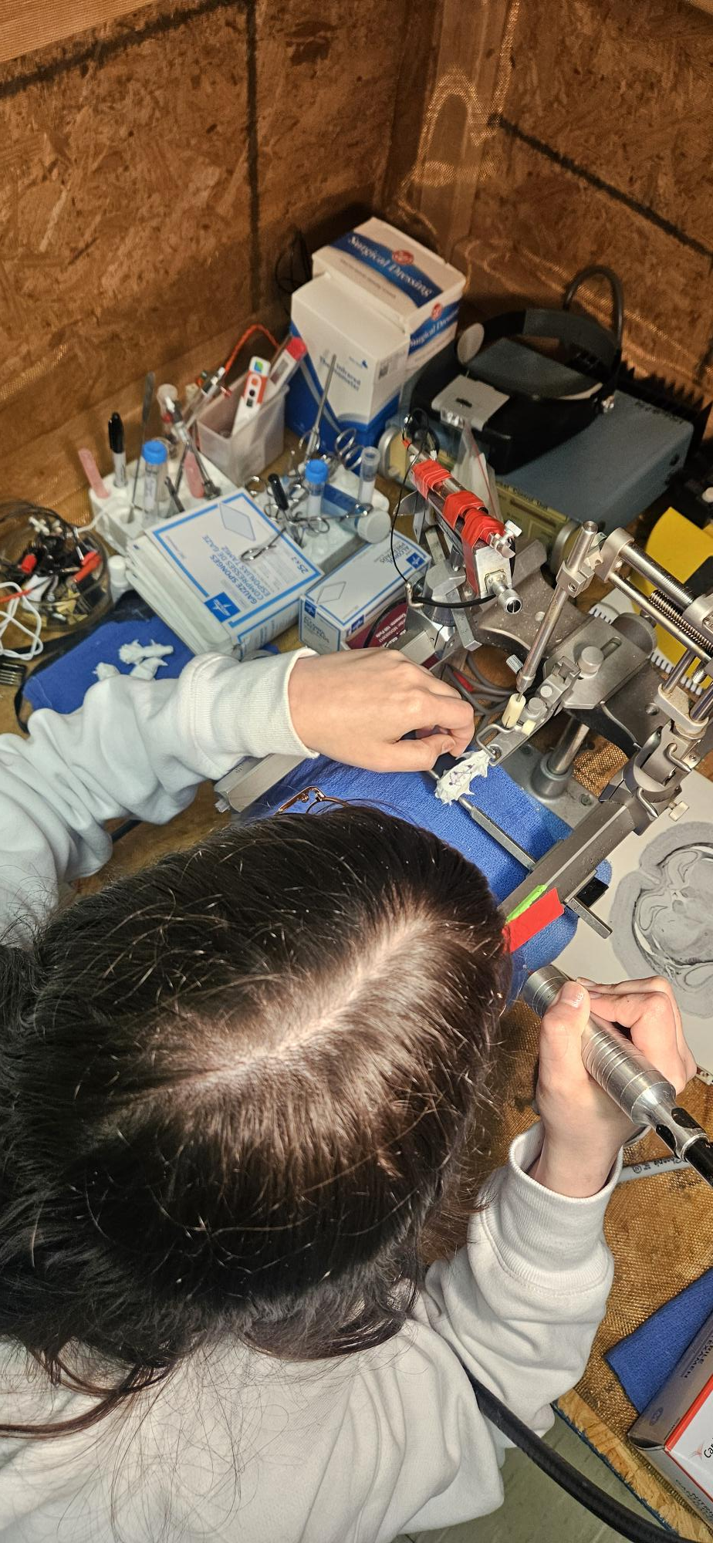
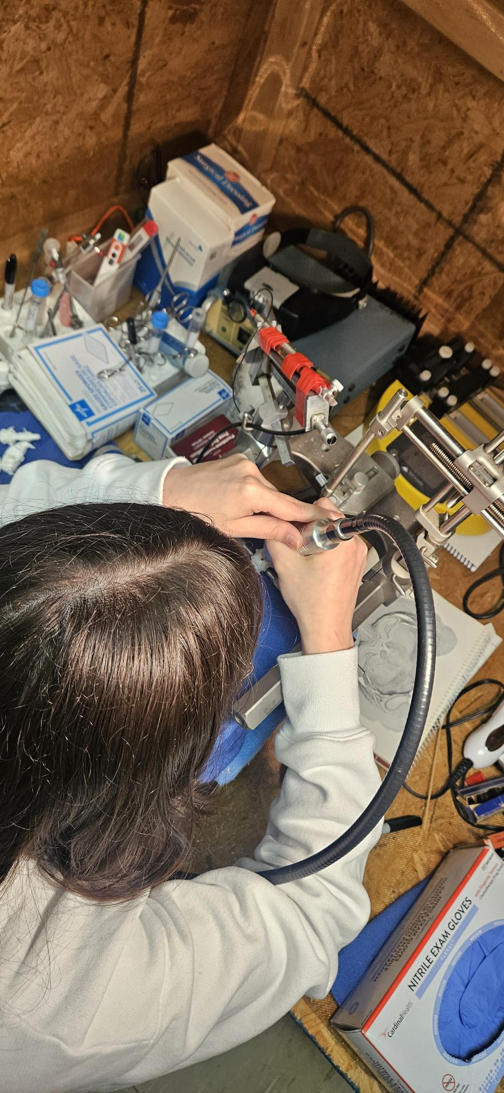
Students Can Then Translate The VR Training
Into Job Market Ready Skills

Slide 12
Job Market Challenge &
Market Opportunity Assessment
Many experts in stereotaxic surgeries for pre-clinical work are aging out of the field.
In most cases, only PhD and MD students at the later stage of their careers are trained in these techniques.
Most international universities/college do not permit early career
skill training in these areas due to ethics, costs, and animal rights.

Slide 13
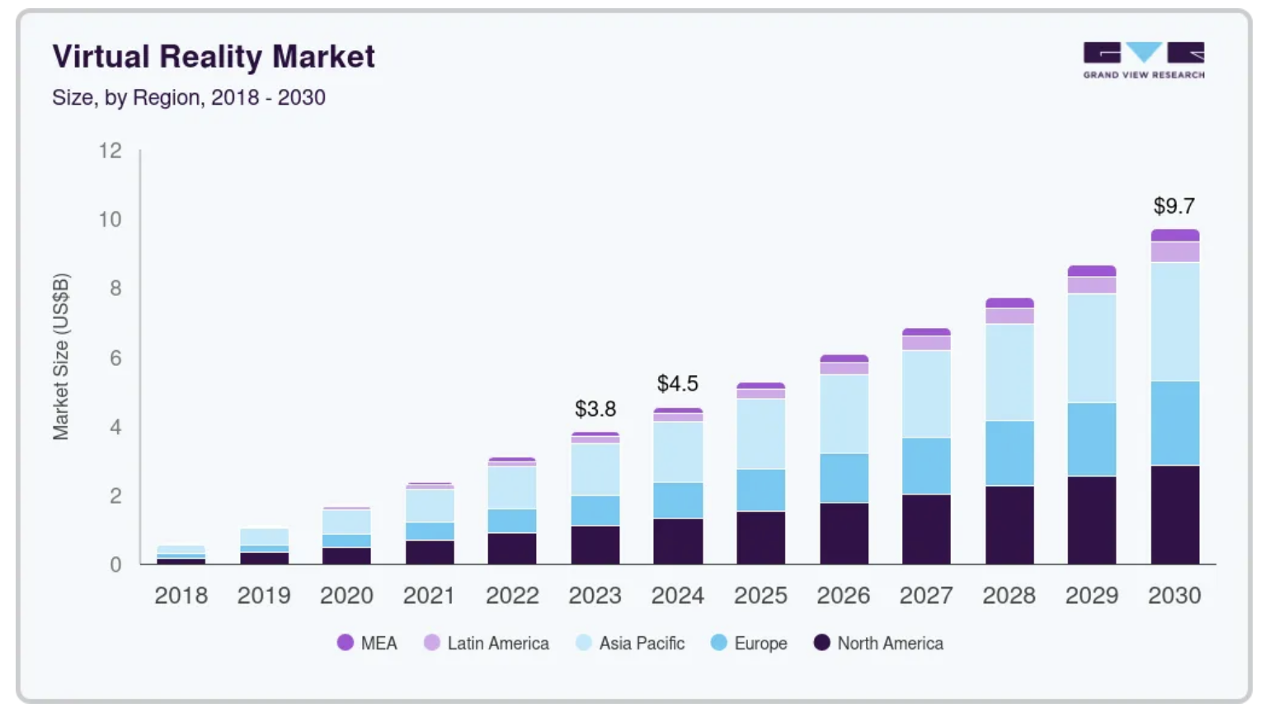
Virtual Reality Market Analysis Report 2018-2030 (Grand View Research)
Global VR market size was estimated at $59.6 billion
USD in 2022.
Global VR market is projected to reach $435.46 billion
USD by 2030.
Growing at a CAGR of 27.5% (2023-2030).
By device Head-mounted displays (HMD) recorded
largest revenue share of 61.9% (2022).
Technology (semi & fully immersive segments recorded
largest revenue share of 82.7% (2022).
Application commercial segment recorded largest
Revenue share of 54.7% (2022).
Asia Pacific: Largest market in 2022 (39%).
Europe: Fastest growing market.
https://www.grandviewresearch.com/industry-analysis/virtual-reality-vr-market

Slide 14
Prospective Student’s Return on Investment
Providing early career training in FP-POV VR to undergraduate students can close the gap.
Serves to upskill and reskill students in the early career pipeline.
Offers high paying jobs in biomedical, tech, and Big Pharma for early drug science and discovery.
Prevents the loss of this rich research technique in the field.
May not need to spend more money on graduate education to earn good wages.

Slide 15
Budget & Funding Plans
$6,000 to purchase 20 Meta Quest 3S VR headsets with remotes.
$740 to purchase 20 facial fans for Meta Quest 3S VR headsets.
$760 to purchase 20 Meta Quest 3S VR headsets and remotes charging stations.
$2,500 to code and develop Error-based learning questions in the VR environment.
$20,000 to develop 4 learning modules for the neuroscience course (one already done).
Run a class with 20 students, $1,600 for 4 credits, generates $32,000 income. Faculty pay for the course $5,600 per semester for 2 semesters and minus $30,000 initial investment, is a net earning of $22,800. Each year 2 modules can be created to build upon the product and still produce an income of $16,400 per class

Slide 16
ROI for Error-based VR Product Development
In 4 years ($137,600) & In 8 years ($348,800)
Expect to pay:
$50 monthly VR management license.
$5,000 per year for maintenance.
If we commercialize and charge the $30 monthly VR fee for our content (i.e., split it 50% us/50% vendor to remove our VR Management license and annual maintenance fees. A single class of 30-50 students using our VR outside our institution could generate another ($450) & ($750) per class per semester.

Slide 17
The Ask
Will need $30,000 in start up to pay for the development of new VR models to embed within the KeyRos Medica Platform.
Will use Goggle AR to develop additional modules to save money.
Will submit grants to cover new product development with KeyRos Medica. Conduct Science as another VR vendor will be the alternative company to work with.
Seek to deploy a pilot study within the next year on a VR only textbook experience in neuroscience.

Slide 18
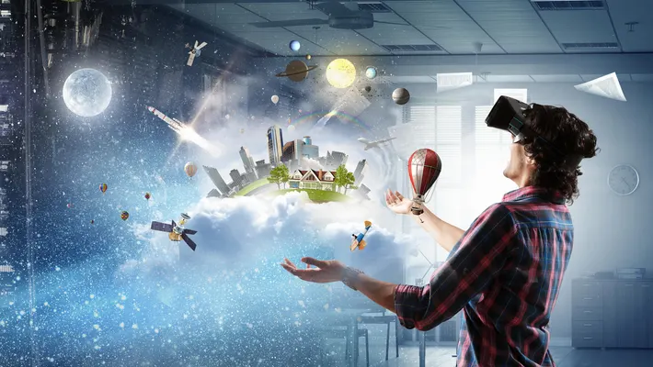
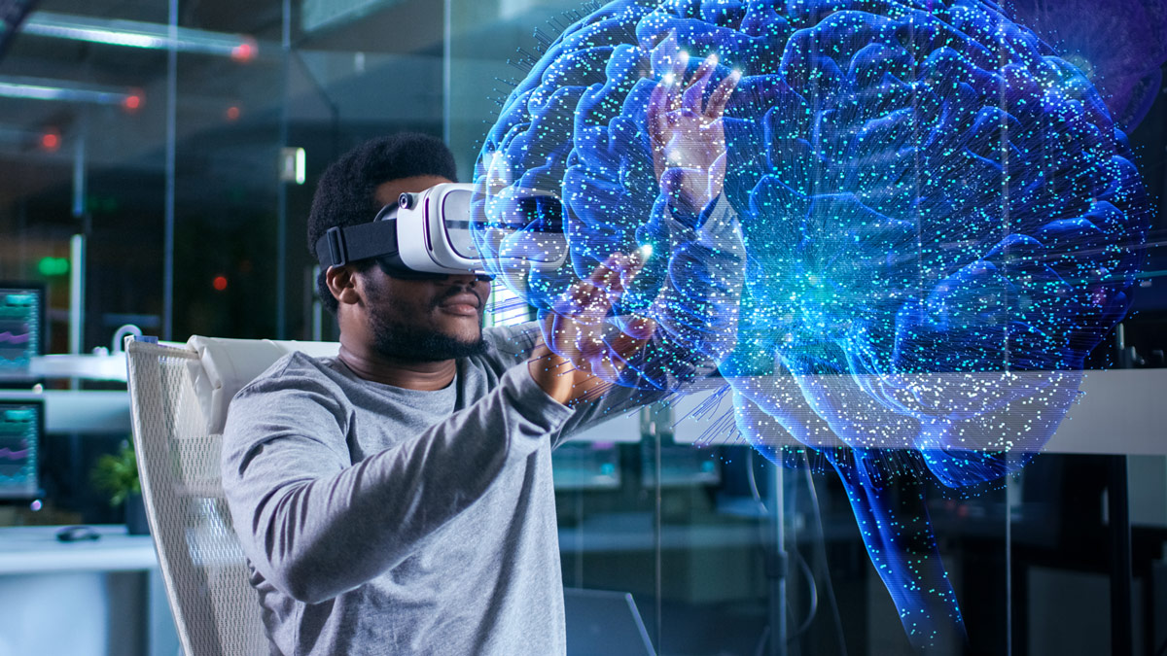
Let’s Make Our University a Pioneer to Make the
First Fully FP-POV VR Living Textbook in Neuroscience
Adapted From: https://www.forbes.com/sites/bernardmarr/2019/07/19/the-important-difference-between-virtual-reality-augmented-reality-and-mixed-reality/
Adapted From: https://www.rit.edu/study/neuroscience-bs

Slide 19
